Slide 1
Project Communication
Give those that want to know, what they need to know.
Notes:
The PM will set the tone for the frequency, medium and tone of communication across the team.

Slide 2
Project Communication
The main process of project communication includes:
Communications planning
Information distribution
Performance reporting
Managing stakeholders
Project communication also includes the methods used for improving project aspects such as:
Managing conflicts
Running effective meetings
Using templates
Notes:
One of the most valuable things you can do for yourself as a PM is to develop a set of templates to consistently use to manage team-wide communication.
Even dates and times can be templates to ensure regular messaging when it is expected by the team.

Slide 3
Communication is Critical
The greatest risk to any project is the failure to communicate.
Strong verbal skills are a key factor in career advancement for any project management professional.
Too often technical competence and communication are perceived as mutually exclusive.

Slide 4
Communication Process
Communications Planning – Determining the information and communications needs of the stakeholders.
Information Distribution – Making needed information available to project stakeholders in a timely manner.
Performance Reporting – Collecting and disseminating performance information, including status reports, progress measurement, and forecasting.
Managing Stakeholders – Managing communications to satisfy the needs and expectations of project stakeholders and to resolve issues.
Notes:
What is being communicated will be role-specific within your project team – make sure you tailor the message to one’s pertinent area of interest.
Similarly, communication is like management – we each have a preferred method of communication. Find out how your team members would like to be contacted.

Slide 5
1. Communications Planning
The Communications Management Plan (CMP) is a document that guides project communications.
Creating a stakeholder analysis for project communications also aids in communications planning.

Slide 6
CMP Contents
Stakeholder communications requirements.
Information to be communicated, including format, content, and level of detail.
The people who will receive the information and who will produce it.
Suggested methods or technologies for conveying the information.
Frequency of communication.
Escalation procedures for resolving issues.
Revision procedures for updating the communications management plan.
A glossary of common terminology.

Slide 7
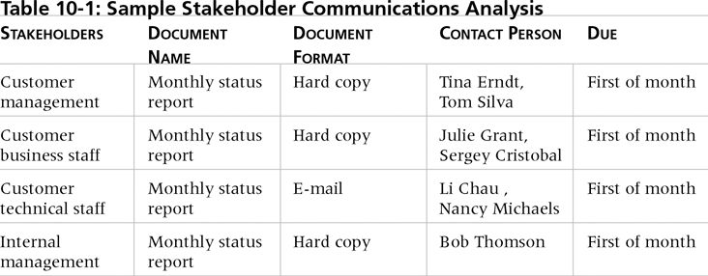
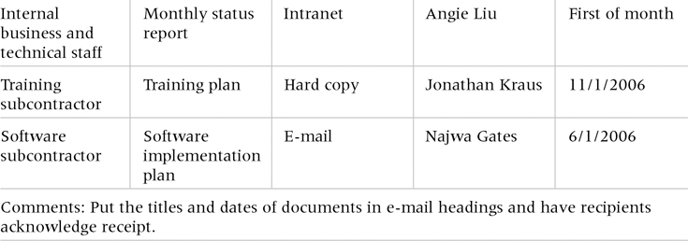
Sample Stakeholder Analysis

Slide 8
2. Information Distribution
Getting the right information to the right people at the right time and in a useful format is just as important as developing the information in the first place.
Important considerations include:
Using technology to enhance information distribution.
Formal and informal methods for distributing information.
Don’t bury crucial information.
Don’t be afraid to report bad information.
Oral communication via meetings and informal talks helps bring important information—good and bad—out into the open.
Notes:
Critical point: Do not deluge people with information they don’t need. Otherwise your messages will end up unread and in the garbage.

Slide 9
Face-to-Face Trumps All
Experience indicates that in a face-to-face interaction:
58 percent of communication is through body language.
35 percent of communication is through how the words are said.
7 percent of communication is through the content or words that are spoken.
Pay attention to more than just the actual words someone is saying.
A person’s tone of voice and body language say a lot about how he or she really feels.

Slide 10
Standup Routine
Short, frequent meetings are often very effective on projects.
Stand-up meetings force people to focus on what they really need to communicate.
Some organizations have policies preventing or blocking e-mail exchange.
Keep them short – no longer than 5 mins.

Slide 11
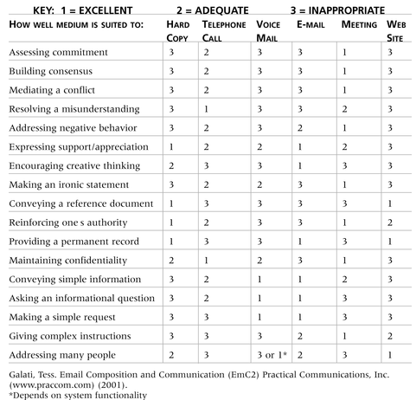
What would you choose?

Slide 12
3. Performance Reporting
Performance reporting keeps stakeholders informed about how resources are being used to achieve project objectives.
Status reports describe where the project stands at a specific point in time.
Progress reports describe what the project team has accomplished during a certain period of time.
Forecasts predict future project status and progress based on past information and trends.

Slide 13
4. Managing Stakeholders
Project managers must understand the motivation and work well with various stakeholders, including executive management:
Need to devise a way to identify and resolve issues.
Two important tools include:
Requirements List
Issue/Corrective Action Log

Slide 14
Issue Log
Notes:
Issue tracking logs need to be updated on a regular basis. If they are not, their value will be undermined.
A team member should be designated as the person responsible for maintaining and updating the log.

Slide 15
Run Effective Meetings
Define the purpose and intended outcome of the meeting.
Determine if a meeting can be avoided.
Determine who should attend the meeting.
Provide an agenda to participants before the meeting.
Prepare handouts and visual aids, and make logistical arrangements ahead of time.
Run the meeting professionally.
Build relationships.
Notes:
Meetings are huge morale- and time-wasters – hold meetings only when necessary.
It is not difficult to conduct an effective meeting with some training and practice.
Contact your trainer for tips on holding effective meetings.

Slide 16
Communicating over E-mail
Be sure to send the e-mail to the right people.
Use meaningful subject lines.
Limit the content to one main subject, and be as clear and concise as possible.
Limit the number and size of attachments.
Delete e-mail you don’t need, and don’t open e-mail if you question the source.
Respond to and file e-mails quickly.

Slide 17
Summary
The goal of project communications management is to ensure timely and appropriate generation, collection, dissemination, storage, and disposition of project information.
Main process include:
Communications planning
Information distribution
Performance reporting
Managing stakeholders

Slide 18
Questions

